Slide 1
NAÏVE BAYESIAN

Slide 2
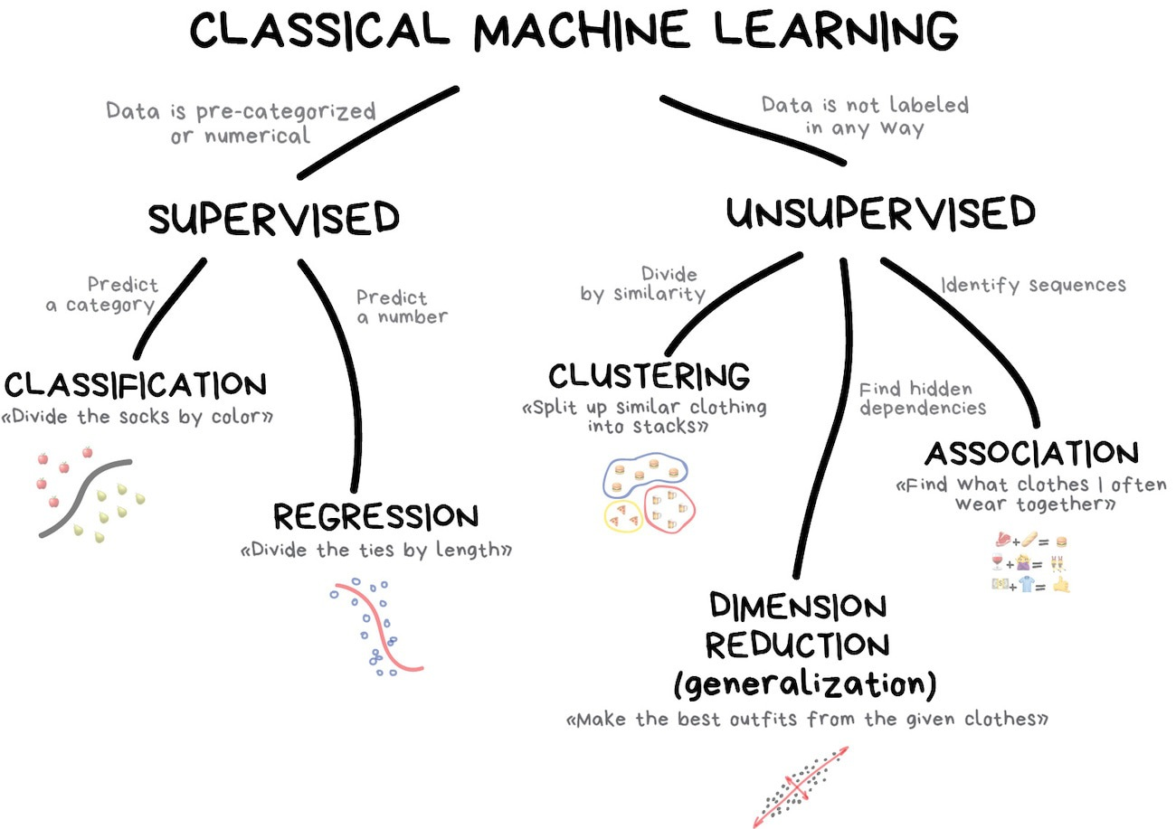

Slide 3












Slide 4

Bayes’ theorem
Probability of the outcome
Class conditional probability
Posterior probability
Probability of the conditions

Slide 5
Bayes Classifier
A probabilistic framework for solving classification problems
Conditional Probability:
Bayes theorem:

Slide 6
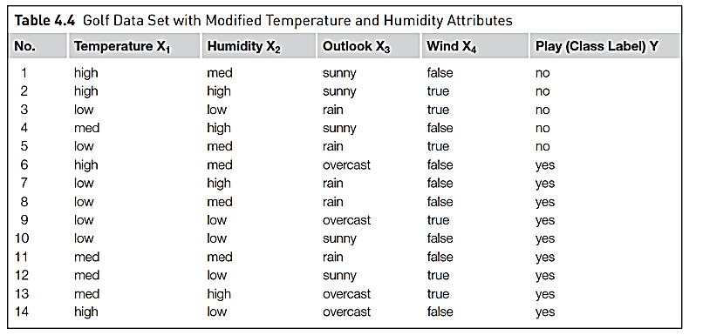
Data set

Slide 7
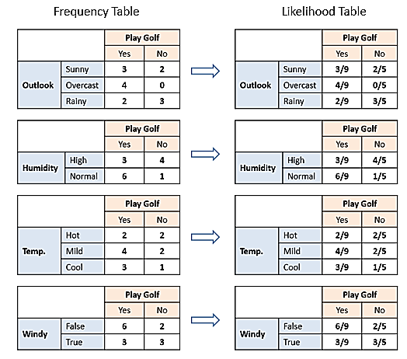

Slide 10
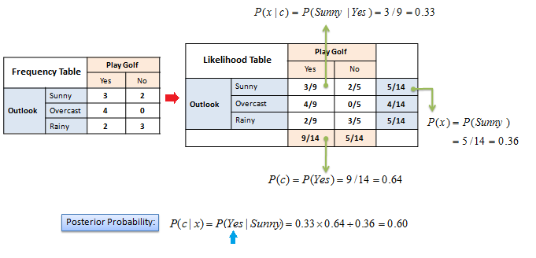

Slide 11
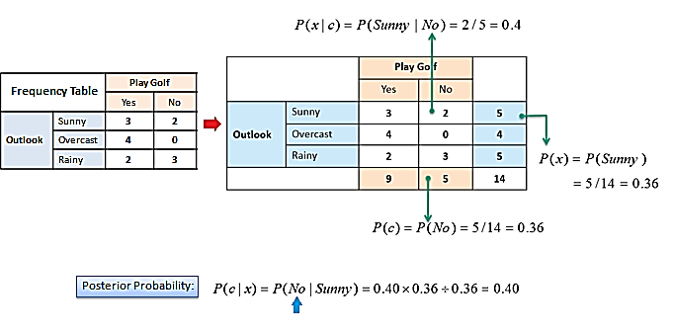

Slide 12
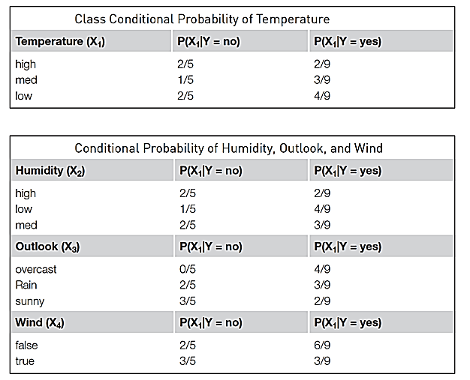
Class conditional probability

Slide 13
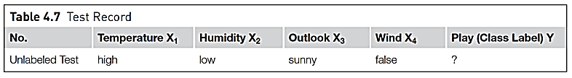
Test record

Slide 14
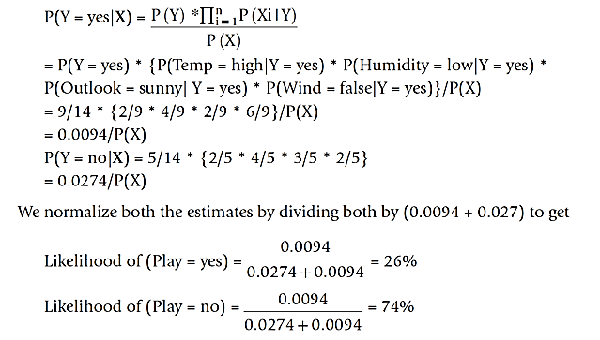
Calculation of posterior probability P(Y/X)
0.0274

Slide 15

Issues
Incomplete training set -> Use laplace correction
Continuous numeric attributes -> Use Probability density function

Slide 16
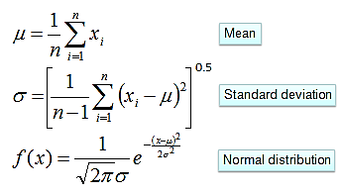
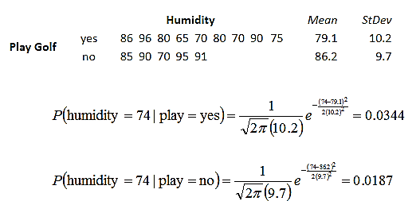
Numerical Predictors

Slide 17





Slide 18
More example NB

Slide 19
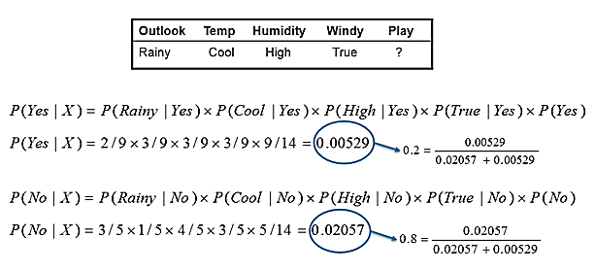





Slide 20
Example of Naïve Bayes Classifier
A: attributes
M: mammals
N: non-mammals
P(A|M)P(M) > P(A|N)P(N)
=> Mammals

Slide 21


